Slide 1
Typography

Slide 2
_________________
The art and technique of arranging type to make language visible.
This involves picking a ____________________________________________________________________________________________________________

Slide 3
Why?
____________ plays an important role in how________________________, by creating relationships between different types of information by ____________ this information and keeping it interesting.

Slide 4
Design Principles for Typography
____________: how easy it is to read text.
____________: You can use typography to create relationships between similar kinds of information.
____________: You generally want to keep words looking the same in a document.

Slide 5
Design Principles for Typography
____________: You can create visual importance using fonts that are different to set up a hierarchy of information.
____________: Setting different levels of importance.

Slide 6
Legibility
Legibility is a combination of factors:
____________
____________
________________________
____________

Slide 7
3 Types of Font
____________
____________
____________

Slide 8
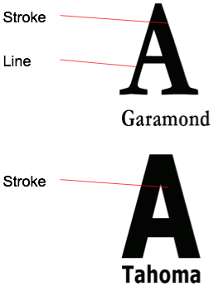
Serifs
____________: Serif fonts have contrasting strokes and lines. They also have little extensions from different parts.
-Helps ____________________ __________________________________ in print and digitally.

Slide 9
Sans- Serifs
____________: Sans-Serifs have uniform strokes throughout. Good for computers, but can be bad when ________________________________________________.

Slide 10



Designer Fonts
These are the fonts that have a lot of character.
Bad for ____________, good for ____________.

Slide 11
Size
When picking font-size, you have to keep in mind your intended audience. Younger readers can see ____________, but older audience may need _________________to read easily.
Font sizes above 14 point tend to be ________________________ for long periods.

Slide 12
Word Spacing
Usually the spaces between letters and words are defined by the ____________ that you pick.
Occasionally you may want to change these.

Slide 13
Alignment
Unless you are trying to create a focal point with a few short words, you almost always want ________________________, as it is the most legible.

Slide 14
Picking Fonts
Different fonts have personality.
-____________tend to be old fashioned, but are “elegant”.
-____________ look very modern and clean, but can be hard to read for extended periods of time.

Slide 15
Body vs. Heading Text
ALWAYS pick a ____________________________________ font for your body paragraphs.
Helvetica, Arial, Times New Roman, Verdana, Calibri or any of the basics.

Slide 16
Body vs. Heading Font
Your headings is where you should get creative.
As always, keep in mind your audience.
-____________ respond to different fonts then ________________________.

Slide 17
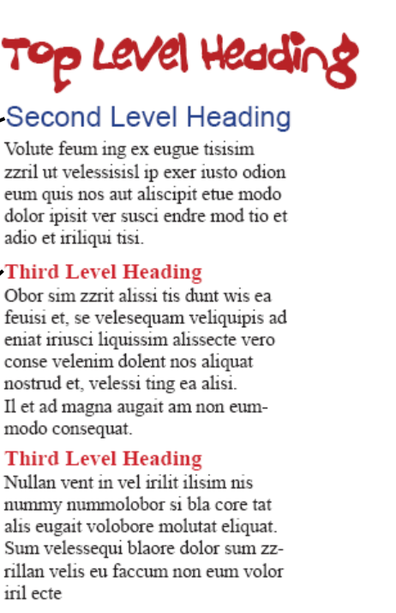
Hierarchy
You can use font to show different levels of importance with ________________________.
-To create a visually interesting website with ____________, you need a hierarchy

